Slide 1
UltraLite Coding
Nicholas Walter
Max Maier
Tyler Hogenson
Ben Finnerty
Spencer Lofing

Slide 2
How did we work?
We had regular weekly meetings.
Usually on Sundays.
We communicated consistently, mostly via text.
We broke up work to be done as Issues on GitHub.

Slide 3
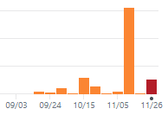
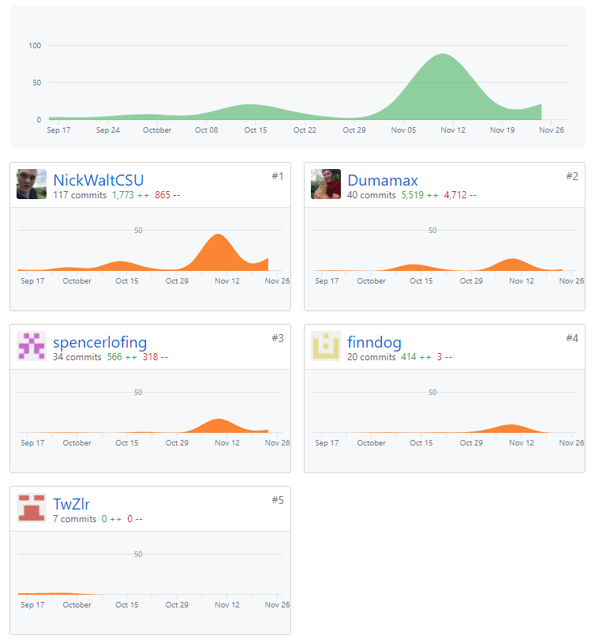
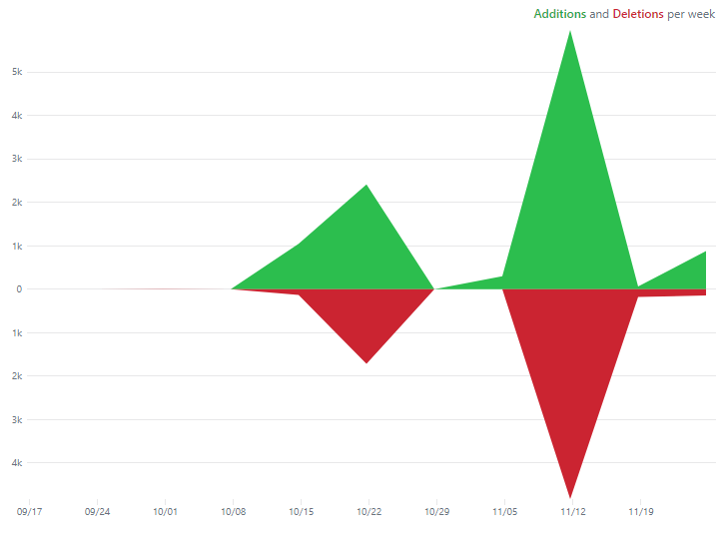
More Information

Slide 4
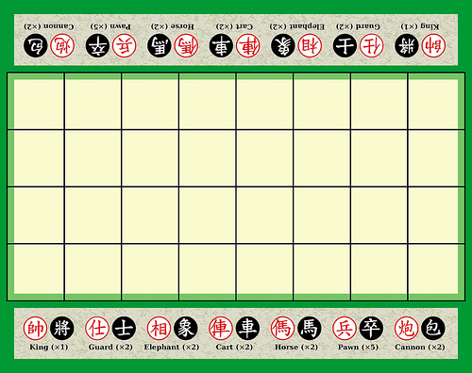
Banqi
Description of Banqi
Half/Blind Chinese Chess – game consists of tokens with various power levels, each placed face-down on the board in a random position. Tokens must be flipped face up (revealing color/power level) before you can move them – higher power level tokens can take lower power level tokens. Soldier can take General, General cannot take Soldier, Cannon can take anything (by jumping).

Slide 5
Code Improvements (Issues Closed)
#72 – Speed up Queries (Spencer)
#75 – Implement Forfeit Game, UI Side (Tyler)
#76 – Improvements to Active Games (Nicholas)
#77 – Add a Refresh to the Board (Tyler)
#82 – Hash Passwords (Spencer)
#83 – Fix Package Extensions (Max)
#86 – Fix Deregister (Spencer)
#88 – Show Color of User on Board (Tyler)
#91 – Implement Forfeit Game, Database Side (Spencer)
#93 – Implement Creator Color (Nicholas)
#95 – Fix Graveyard Issue (Nicholas, Max)

Slide 6
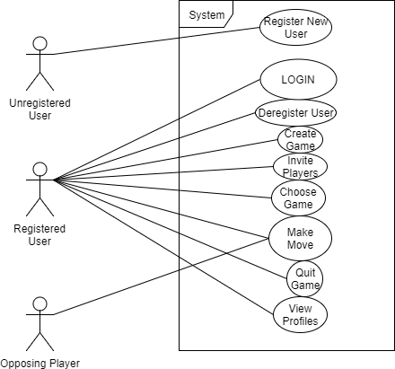
Use Case Document

Slide 7
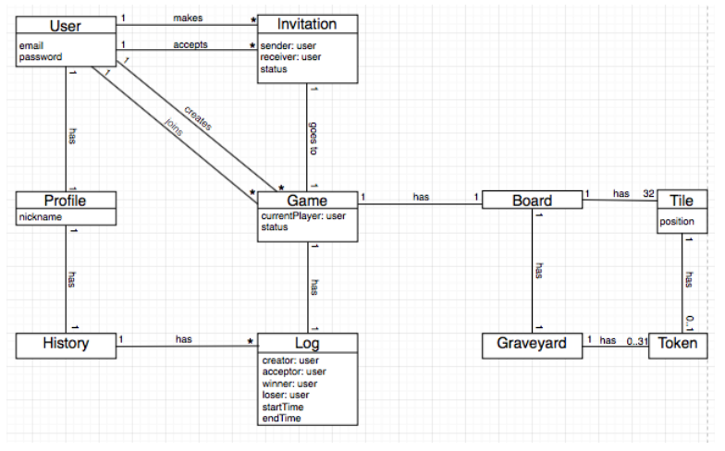
Domain Model Document

Slide 8
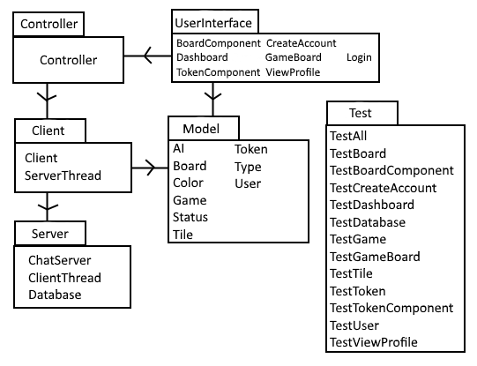
Design Document, Part 1, Package Diagram

Slide 9
Design Document, Part 2, Design Class Diagram

Slide 10
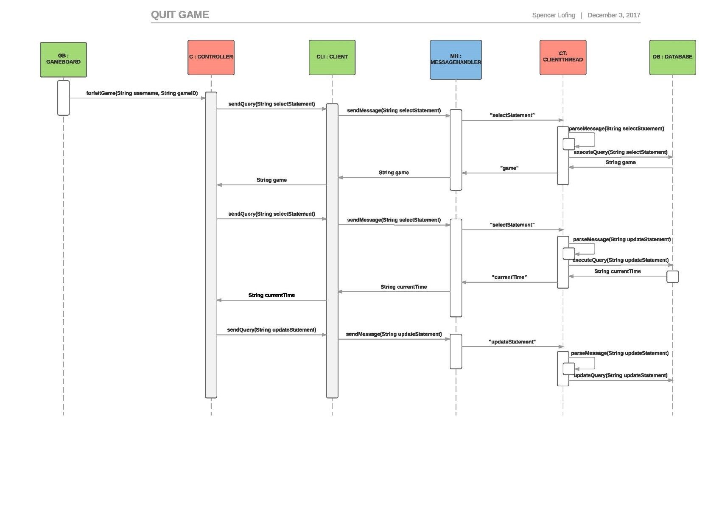
Design Document, Part 3, Sequence Diagram 1

Slide 11
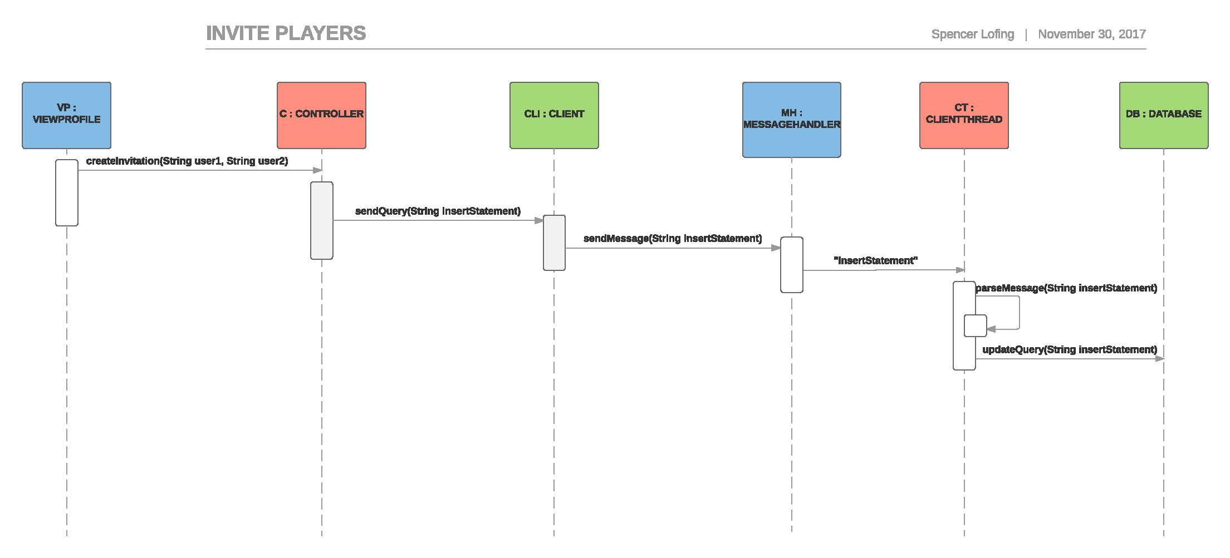
Design Document, Part 3, Sequence Diagram 2

Slide 12
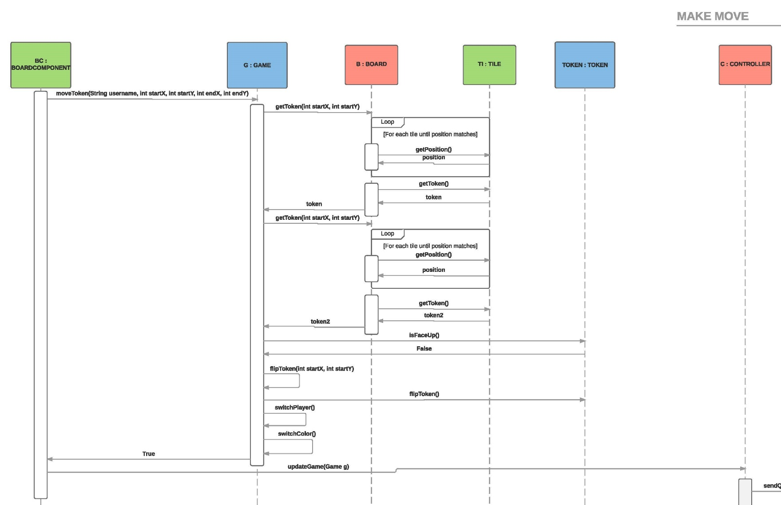
Design Document, Part 3, Sequence Diagram 3.1

Slide 13
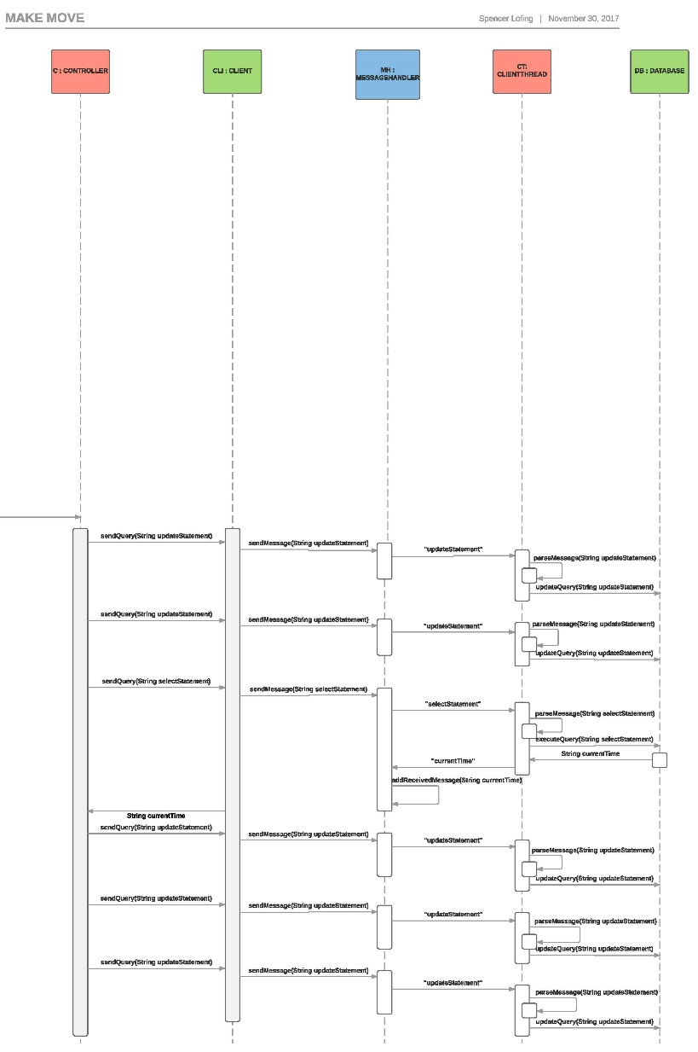
Design Document, Part 3, Sequence Diagram 3.2

Slide 14
Testing Document

Slide 15
Development Manual

Slide 16
Refactoring and Design Pattern List
Separated classes into MVC layout
Model contains all game logic
View contain UI elements
Controller helps with server and database interaction
Implemented Façade Pattern
Mainly within Model package
Extraction of Code
Rearranged class structure to reduce coupling
Removed unneeded/unused classes
Log, Profile, Invitation

Slide 17
Traceability Link Matrix

Slide 18
Challenges and Lessons Learned
Teamwork:
Challenge: we struggled to follow through on our plans.
Lesson: make more manageable plans.
Communication:
Challenge: we struggled to communicate our difficulties.
Lesson: communicate our difficulties.
Software Design:
Challenge: we struggled to do TDD or use Agile Methodology.
Lesson: making more time for work allows us to work how we want to.
Software Development:
Challenge: we struggled to implement as many design patterns as we would’ve liked.
Lesson: making more time for work allows us to implement what we want to.
Commit Log:
Challenge: 156 commits the week of November 12th.
Lesson: ensure all group members are doing their parts before the weekend before the due date.

Slide 19
Demo

